Slide 1
Memory Hierarchy
60080013: Computer Organization
6th Lecture
Instructors:
Sun Heng

Slide 2
Random-Access Memory (RAM)
A memory system is a hierarchy of storage devices with different capacities, costs, and access times. CPU registers hold the most frequently used data. Small, fast cache memories nearby the CPU act as staging areas for a subset of the data and instructions stored in the relatively slow main memory. The main memory stages data stored on large, slow disks, which in turn often serve as staging areas for data stored on the disks or tapes of other machines connected by networks.

Slide 3
Random-Access Memory (RAM)
This idea centers around a fundamental property of computer programs known as locality. Programs with good locality tend to access the same set of data items over and over again, or they tend to access sets of nearby data items. Programs with good locality tend to access more data items from the upper levels of the memory hierarchy than programs with poor locality, and thus run faster. For example, on our Core i7 system, the running times of different matrix multiplication kernels that perform the same number of arithmetic operations, but have different degrees of locality, can vary by a factor of almost 40!

Slide 4
Random-Access Memory (RAM)
Key features
  RAM is traditionally packaged as a chip.
  Basic storage unit is normally a cell (one bit per cell).
  Multiple RAM chips form a memory.
RAM comes in two varieties:
  SRAM (Static RAM)
  DRAM (Dynamic RAM)

Slide 5
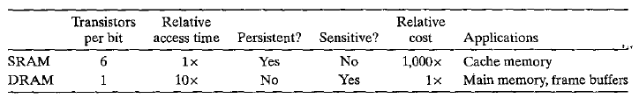
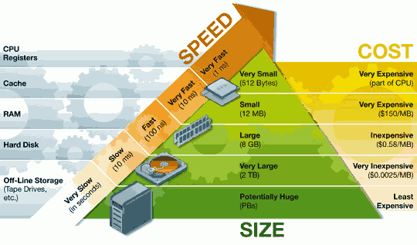
SRAM vs DRAM Summary

Slide 6
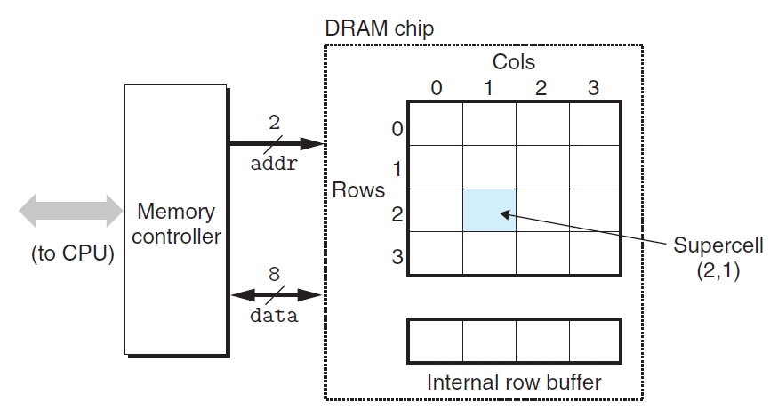
Conventional DRAMs

Slide 7
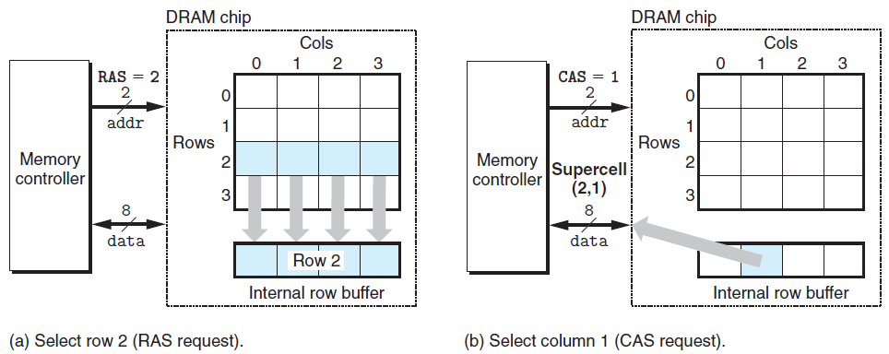
Conventional DRAMs

Slide 8
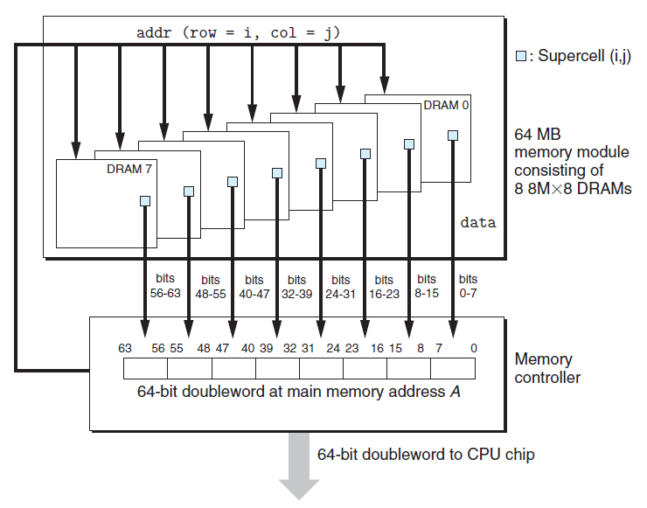
Memory Modules

Slide 9
Enhanced DRAMs
Basic DRAM cell has not changed since its invention in 1966.
  Commercialized by Intel in 1970.
DRAM cores with better interface logic and faster I/O :
  Synchronous DRAM (SDRAM)
    Uses a conventional clock signal instead of asynchronous control
    Allows reuse of the row addresses
  Double data-rate synchronous DRAM (DDR SDRAM)
    Double edge clocking sends two bits per cycle per pin
    Different types distinguished by size of small prefetch buffer:
      DDR (2 bits), DDR2 (4 bits), DDR3 (8 bits) , DDR4 (8 bits ) , DDR5 (16 bits)
    By 2010, standard for most server and desktop systems
    SKhynix releases the first DDR5 memory in October, 2020.

Slide 10
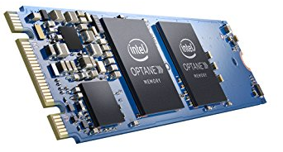
Nonvolatile Memories
DRAM and SRAM are volatile memories
  Lose information if powered off.
Nonvolatile memories retain value even if powered off
  Read-only memory (ROM): programmed during production
  Programmable ROM (PROM): can be programmed once
  Eraseable PROM (EPROM): can be bulk erased (UV, X-Ray)
  Electrically eraseable PROM (EEPROM): electronic erase capability
  Flash memory: EEPROMs, with partial (block-level) erase capability
    Wears out after about 100,000 erasings
  3D XPoint (Intel Optane) & emerging NVMs
    New materials
Uses for Nonvolatile Memories
  Firmware programs stored in a ROM (BIOS, controllers for disks, network cards, graphics accelerators, security subsystems,…)
  Solid state disks (replace rotating disks in thumb drives, smart phones, mp3 players, tablets, laptops, data centers,…)
  Disk caches

Slide 11
Traditional Bus Structure Connecting
CPU and Memory
A bus is a collection of parallel wires that carry address, data, and control signals.
Buses are typically shared by multiple devices.
CPU chip
Register file
ALU
System bus
Memory bus
Main
memory
Bus interface
I/O
bridge

Slide 12
Memory Read Transaction (1)
CPU places address A on the memory bus.
Register file
Load operation: movq A, %rax
ALU
%rax
Main memory
I/O bridge
A
0
Bus interface
x
A

Slide 13
Memory Read Transaction (2)
Main memory reads A from the memory bus, retrieves word x, and places it on the bus.
Register file
Load operation: movq A, %rax
ALU
%rax
Main memory
I/O bridge
x
0
Bus interface
x
A

Slide 14
Memory Read Transaction (3)
CPU read word x from the bus and copies it into register %eax.
Register file
Load operation: movq A, %rax
ALU
%rax
x
Main memory
I/O bridge
0
Bus interface
x
A

Slide 15
Memory Write Transaction (1)
CPU places address A on bus. Main memory reads it and waits for the corresponding data word to arrive.
Register file
Store operation: movq %rax, A
ALU
%rax
y
Main memory
I/O bridge
0
A
Bus interface
A

Slide 16
Memory Write Transaction (2)
CPU places data word y on the bus.
Register file
Store operation: movq %rax, A
ALU
%rax
y
Main memory
I/O bridge
y
0
Bus interface
A

Slide 17
Memory Write Transaction (3)
Main memory reads data word y from the bus and stores it at address A.
register file
Store operation: movq %rax, A
ALU
%rax
y
main memory
I/O bridge
0
bus interface
y
A

Slide 18
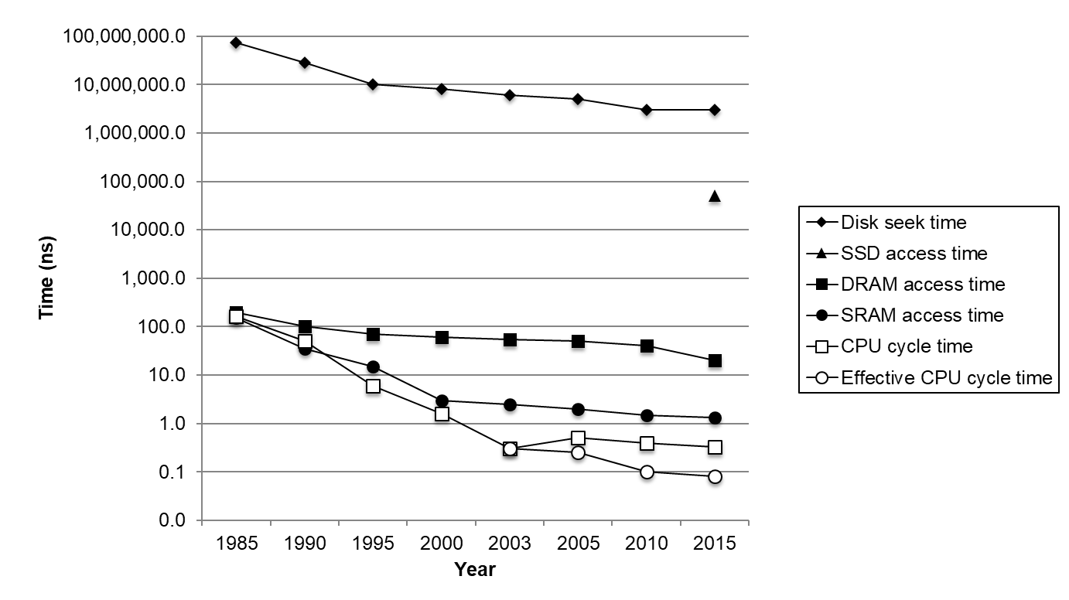
The CPU-Memory Gap
Disk
SSD
DRAM
CPU

Slide 19
Locality to the Rescue!
The key to bridging this CPU-Memory gap is a fundamental property of computer programs known as locality.

Slide 20
Locality
Principle of Locality: Programs tend to use data and instructions with addresses near or equal to those they have used recently
Temporal locality:
  Recently referenced items are likely
  to be referenced again in the near future
Spatial locality:
  Items with nearby addresses tend
  to be referenced close together in time

Slide 21
Locality Example
sum = 0;
for (i = 0; i < n; i++)
sum += a[i];
return sum;
Data references
  Reference array elements in succession (stride-1 reference pattern).
  Reference variable sum each iteration.
Instruction references
  Reference instructions in sequence.
  Cycle through loop repeatedly.
Spatial locality
Temporal locality
Spatial locality
Temporal locality

Slide 22
Qualitative Estimates of Locality
Claim: Being able to look at code and get a qualitative sense of its locality is a key skill for a professional programmer.
Question: Does this function have good locality with respect to array a?
int sumarrayrows(int a[M][N])
{
int i, j, sum = 0;
for (i = 0; i < M; i++)
for (j = 0; j < N; j++)
sum += a[i][j];
return sum;
}

Slide 23
Locality Example
Question: Does this function have good locality with respect to array a?
int sumarraycols(int a[M][N])
{
int i, j, sum = 0;
for (j = 0; j < N; j++)
for (i = 0; i < M; i++)
sum += a[i][j];
return sum;
}

Slide 24
Classwork
Problem 6.8.

Slide 25
Memory Hierarchies
Some fundamental and enduring properties of hardware and software:
  Fast storage technologies cost more per byte, have less capacity, and require more power (heat!).
  The gap between CPU and main memory speed is widening.
  Well-written programs tend to exhibit good locality.
These fundamental properties complement each other beautifully.
They suggest an approach for organizing memory and storage systems known as a memory hierarchy.

Slide 26
An Example Memory Hierarchy
L0:
CPU registers hold words retrieved from L1 cache
Registers
L1:
L1 cache
(SRAM)
Smaller,
faster,
costlier
per byte
L1 cache holds cache lines retrieved from L2 cache
L2:
L2 cache
(SRAM)
L2 cache holds cache lines retrieved from main memory
L3:
Larger,
slower,
cheaper
per byte
Main memory
(DRAM)
Main memory holds disk blocks retrieved from local disks
L4:
Local secondary storage
(local disks)
Local disks hold files retrieved from disks on remote network servers
Remote secondary storage
(tapes, distributed file systems, Web servers)
L5:

Slide 27
Caches
Cache: A smaller, faster storage device that acts as a staging area for a subset of the data in a larger, slower device.

Slide 28
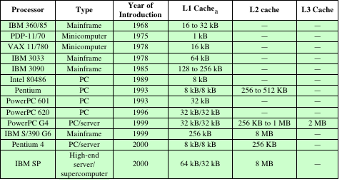
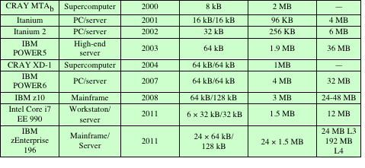
Cache Sizes of Some Processors
ª Two values separated by a slash refer to instruction and data caches.
^{b} Both caches are instruction only; no data caches.

Slide 29
General Cache Concepts
Smaller, faster, more expensive
memory caches a subset of
the blocks
Cache
8
4
9
14
10
3
Data is copied in block-sized transfer units
4
10
Larger, slower, cheaper memory
viewed as partitioned into “blocks”
Memory
0
1
2
3
4
4
5
6
7
8
9
10
10
11
12
13
14
15

Slide 30
General Cache Concepts: Hit
Request: 14
Data in block d is needed
Cache
Block d is in cache:
Hit!
8
9
14
3
14
Memory
0
1
2
3
4
5
6
7
8
9
10
11
12
13
14
15

Slide 31
General Cache Concepts: Miss
Request: 12
Data in block d is needed
Cache
Block d is not in cache:
Miss!
8
9
14
3
12
Block d is fetched from
memory
12
Request: 12
Block d is stored in cache
Placement policy:
determines where d goes
Replacement policy:
determines which block
gets evicted (victim)
Memory
0
1
2
3
4
5
6
7
8
9
10
11
12
12
13
14
15

Slide 32
General Caching Concepts:
Types of Cache Misses
Cold (compulsory) miss
  Cold misses occur because the cache is empty.
Conflict miss
  Most caches limit blocks in memory to a small subset (sometimes a singleton) of the block positions in cache.
    E.g. Block i in memory must be placed in block (i mod 4) in cache.
  Conflict misses occur when the cache is large enough, but multiple data objects all map to the same cache block.
    E.g. Referencing blocks 0, 8, 0, 8, 0, 8, ... would miss every time.
Capacity miss
  Occurs when the set of active cache blocks (working set) is larger than the cache.

Slide 33
Cache Memories
Cache memories are small, fast SRAM-based memories managed automatically in hardware
  Hold frequently accessed blocks of main memory
CPU looks first for data in cache, then in main memory
Typical system structure:
CPU chip
Register file
ALU
Cache
memory
System bus
Memory bus
Main
memory
Bus interface
I/O
bridge

Slide 34
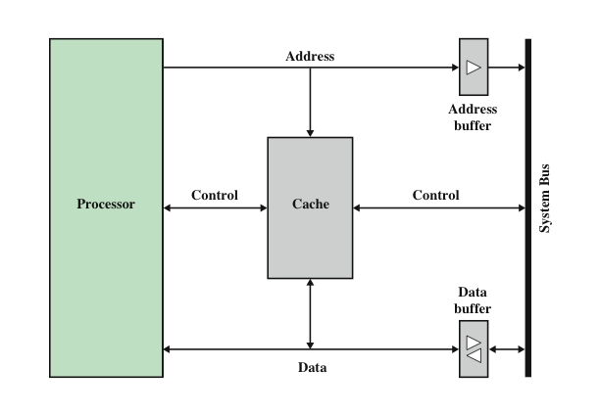
Typical Cache Organization

Slide 35
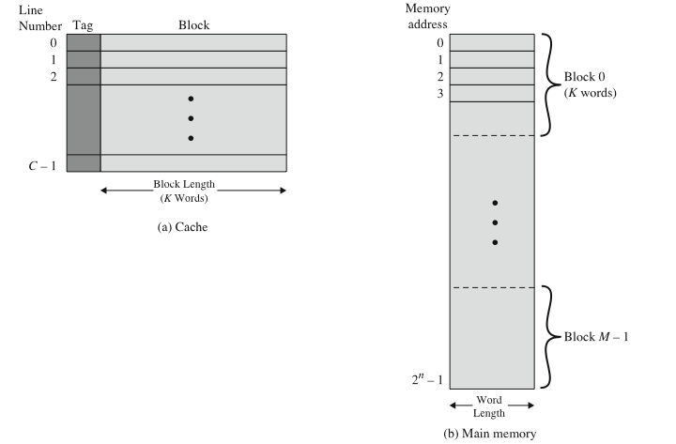
Cache/Main Memory Structure

Slide 36
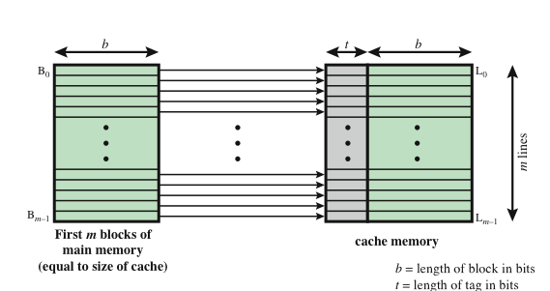
Direct Mapping

Slide 37
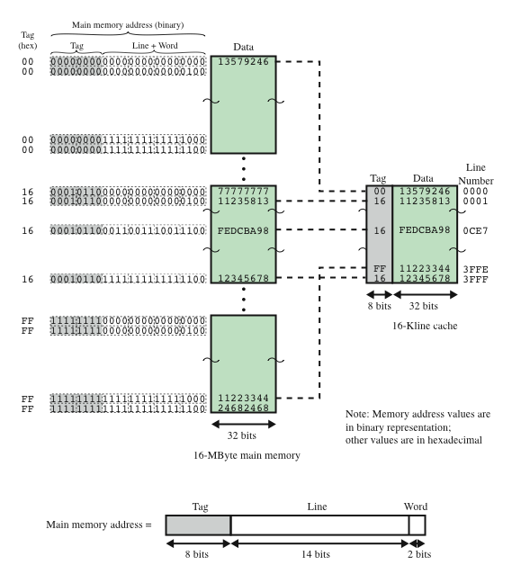
Direct
Mapping
Example

Slide 38
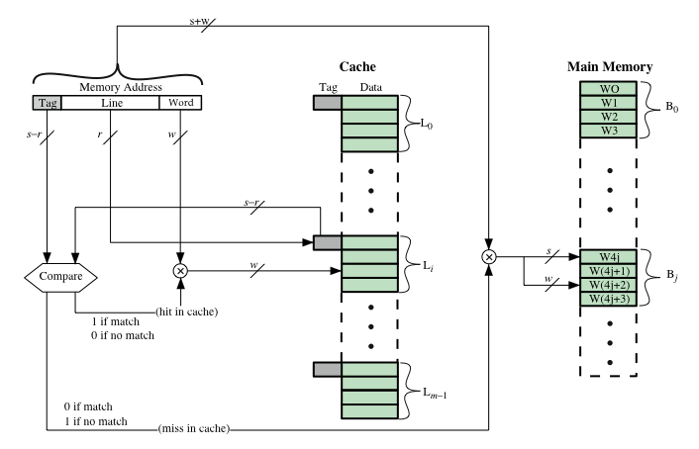
Direct Mapping Cache Organization

Slide 39

Direct Mapping Summary
Address length = (s + w) bits
Number of addressable units = 2^{s+w} words or bytes
Block size = line size = 2^{w} words or bytes
Number of blocks in main memory = 2^{s+ w}/2^{w} = 2^{s}
Number of lines in cache = m = 2^{r}
Size of tag = (s – r) bits

Slide 40
Magnetic Disk
A disk is a circular platter constructed of nonmagnetic material, called the substrate, coated with a magnetizable material
  Traditionally the substrate has been an aluminium or aluminium alloy material
  Recently glass substrates have been introduced
Benefits of the glass substrate:
  Improvement in the uniformity of the magnetic film surface to increase disk reliability
  A significant reduction in overall surface defects to help reduce read-write errors
  Ability to support lower fly heights
  Better stiffness to reduce disk dynamics
  Greater ability to withstand shock and damage

Slide 41
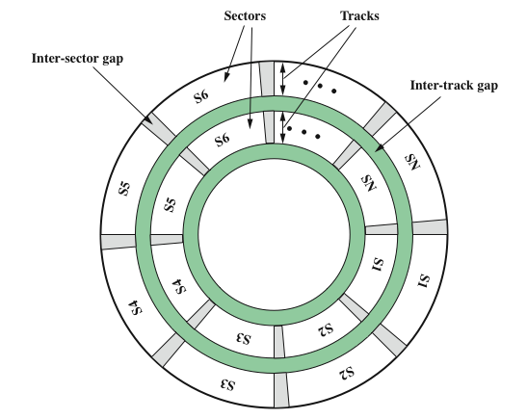
Disk Data Layout

Slide 42
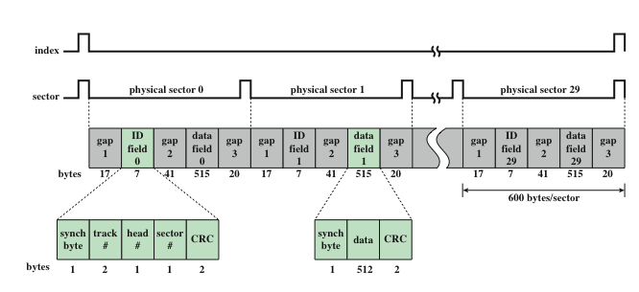
Winchester Disk Format
Seagate ST506

Slide 43
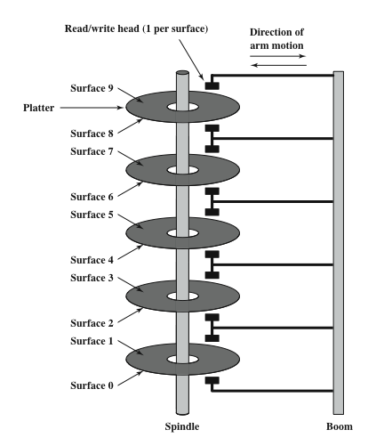
Multiple Platters

Slide 44
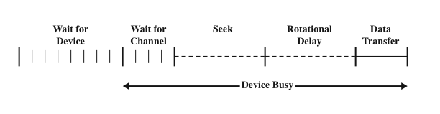
Timing of Disk I/O Transfer

Slide 45
Disk Performance Parameters
When the disk drive is operating the disk is rotating at constant speed
To read or write the head must be positioned at the desired track and at the beginning of the desired sector on the track
  Track selection involves moving the head in a movable-head system or electronically selecting one head on a fixed-head system
  Once the track is selected, the disk controller waits until the appropriate sector rotates to line up with the head
Seek time
  On a movable–head system, the time it takes to position the head at the track
Rotational delay (rotational latency)
  The time it takes for the beginning of the sector to reach the head
Access time
  The sum of the seek time and the rotational delay
  The time it takes to get into position to read or write
Transfer time
  Once the head is in position, the read or write operation is then performed as the sector moves under the head
  This is the data transfer portion of the operation

Slide 46
Seek Time
Seek time is the time required to move the disk arm to the required track. It turns out that this is a difficult quantity to pin down. The seek time consists of two key components: the initial startup time, and the time taken to traverse the tracks that have to be crossed once the access arm is up to speed. Unfortunately, the traversal time is not a linear function of the number of tracks, but includes a settling time (time after positioning the head over the target track until track identification is confirmed).
Much improvement comes from smaller and lighter disk components. Some years ago, a typical disk was 14 inches (36 cm) in diameter, whereas the most common size today is 3.5 inches (8.9 cm), reducing the distance that the arm has to travel. A typical average seek time on contemporary hard disks is under 10 ms.

Slide 47
Rotational Delay
Disks rotate at speeds ranging from 3600 rpm (for handheld devices such as digital cameras) up to, as of this writing, 20,000 rpm; at this latter speed, there is one revolution per 3 ms. Thus, on the average, the rotational delay will be 1.5 ms.

Slide 48


Transfer Time
The transfer time to or from the disk depends on the rotation speed of the disk in the following fashion:
where
T = transfer time
b = number of bytes to be transferred
N = number of bytes on a track
r = rotation speed, in revolutions per second
Thus the total average access time can be expressed as
where Ts is the average seek time. Note that on a zoned drive, the number of bytes per track is variable, complicating the calculation.

Slide 49
Timing Comparison
Look at two different I/O operations that illustrate the danger of relying on average values. Consider a disk with an advertised average seek time of 4 ms, rotation speed of 15,000 rpm, and 512-byte sectors with 500 sectors per track. Suppose that we wish to read a file consisting of 2500 sectors for a total of 1.28 Mbytes. We would like to estimate the total time for the transfer.

Slide 50
Sequential Organization
assume that the file is stored as compactly as possible on the disk. That is, the file occupies all of the sectors on 5 adjacent tracks (5 tracks * 500 sectors/track = 2500 sectors).
The time to read the first track is as follows:
Average seek 4 ms
Average rotational delay 2 ms
Read 500 sectors 4 ms
= 10 ms
Total time = 10 + (4 * 6) = 34 ms = 0.034 seconds

Slide 51
Random Organization
The sectors are distributed randomly over the disk:
Average seek 4 ms
Rotational delay 2 ms
Read 1 sectors 0.008 ms
6.008 ms
Total time = 2500 * 6.008 = 15,020 ms = 15.02 seconds

